Slide 1
Employee Data Analysis using Excel
STUDENT NAME : E.Dillirani
REGISTER NO:312214852
NMID:7F7B3D240BE624C93544E2564FF111EA
DEPARTMENT: Department of commerce
COLLEGE: ANNAI VELANKANNI COLLEGE FOR WOMEN

Slide 2
PROJECT TITLE
Employee Performance Analysis using Excel

Slide 3


AGENDA
Problem Statement
Project Overview
End Users
Our Solution and Proposition
Dataset Description
Modelling Approach
Results and Discussion
Conclusion
3/21/2024 Annual Review

Slide 4

PROBLEM STATEMENT
In this project , we are analyzing employee performance using excel to track the working skills of the employees in their job role.
We can motivate the employees whose performace level are low .
We can give rewards to employees whose performace level are high and very high to improve their current performance.
We can track the contribution made by the employees towards the growth and development of the business

Slide 5

PROJECT OVERVIEW
In this project we are analyzing about the employees and their performance level using pivot table and graphs in excel
This project shows the level of performance of the employees from different type of business unit in the organnisation
The level of performace are categorized into four level are :
1) very high
2) high
3) med
4) low
.

Slide 6

WHO ARE THE END USERS?
1) Organisation
2) Employers
3)Managers
4)Employee

Slide 7

OUR SOLUTION AND ITS VALUE PROPOSITION
THE TECHNIQUES USED:
Conditional formatting : to highlight missing values
Filter : removing the missing exit date
Formula : for calculating employee performace
Pivot table: summarize the employee performace analysis
Graph chart and pie chart : Data Visualization

Slide 8
Dataset Description
We took the employee dataset which is given for project . The dataset contains 26 features . But we used only 9 features in it
2. All the 9 features are the following:
emp id- num
first name- text
emp type- full time , part time, contract
performace level- high,low,med,very high
gender- women, men
business unit- text
emp rating- numeric
preformace scores- text
emp status- text

Slide 9

THE "WOW" IN OUR SOLUTION
We used particular formula for finding the performance level of employee
The formula is :
=IFS(Z8>=5,"VERY HIGH",Z8>=4,"HIGH",Z8>=3,"MED",TRUE,"LOW")
3/21/2024 Annual Review
‹#›

Slide 10
MODELLING
DATA COLLECTION:
1)The data is taken from edunet foundation dash board.
2) the dataset contains the employee details
3) the dataset contains 26 features of the employees
FEATURE COLLECTION:
1)We took 9 features out of the 26 features in the dataset
2) Those features are empid , first name, last name,
business unit,emp type, emp status, gender, emp
performance scores, emp ranking
3) These features are used in employee performace analysis
for tracking the working skills of employees
‹#›

Slide 11
DATA CLEANING:
1) We found the missing values using the conditional
formatting in the exit date by highlighting the blank values
2) We seprated those missing blank values using the
filtering method.
PERFORMANCE LEVEL:
1) We found the performace level using the
performance rating column.
2) we used a formula to find the performance level of
employee. The formula is
=IFS(Z9>=5,"VERY HIGH",Z9>=4,"HIGH",Z9>=3,"MED",TRUE,"LOW")
SUMMARY:
1)We used pivot table to summarize the employee performance.
2) We used graph and pie chart for data visualization which helps
in better understanding for the people

Slide 12
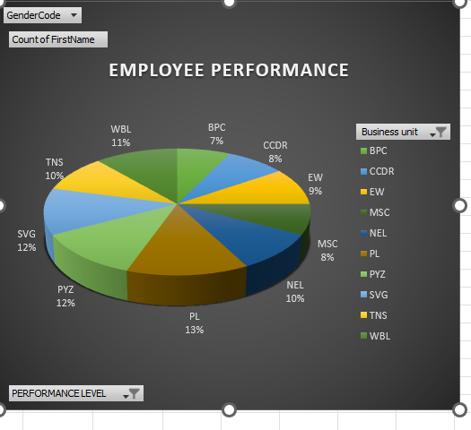
RESULTS
‹#›

Slide 13
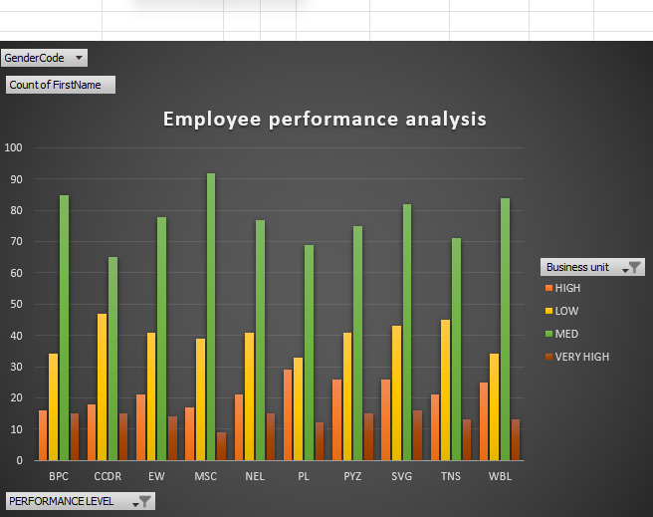
BAR GRAPH

Slide 14
conclusion
In the analysis, we found employee performance level from various business unit in the organisation . In that we found the performance of the PL unit is 13% which is highest performance and following by PYZ , SVG is 12% . The employees from these business unit are performing well than other units in the organisation.
We used the pivot table for summarizing the performance of each unit and found the best performing business unit. We used the bar graph and pie chart for data visualization which helped us in understanding well about the situation. The best performed business unit employees will get rewards and incentives to motivate them for working hard

